Slide 1

Chapter 1
Overview of an Engineering Drawing

Slide 2
TOPICS
Graphics language
Engineering drawing
Projection methods
Orthographic projection
Drawing standards

Slide 3
TOPICS
Traditional Drawing Tools
Lettering
Freehand Sketching

Slide 4
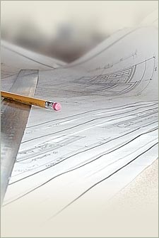
GRAPHICS LANGUAGE

Slide 5
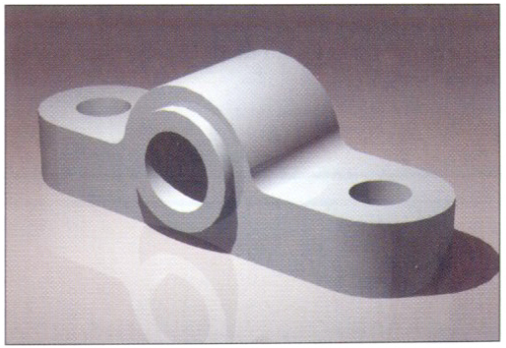
Effectiveness of Graphics Language
1. Try to write a description of
this object.
2. Test your written description
by having someone attempt to make a sketch from your
description.
You can easily understand that …
The word languages are inadequate for describing the size, shape and features completely as well as concisely.

Slide 6
Composition of Graphic Language
Graphic language in “engineering application” use
lines to represent the surfaces, edges and contours of objects.
The language is known as “drawing” or “drafting” .
A drawing can be done using freehand, instruments or computer methods.

Slide 7
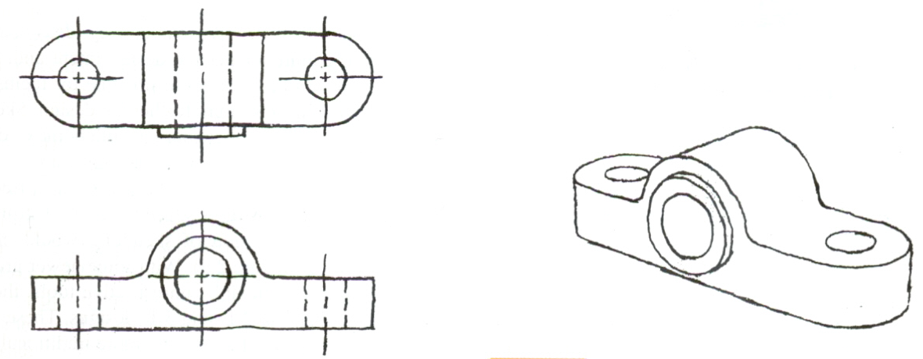
Freehand drawing
The lines are sketched without using instruments other than pencils and erasers.
Example

Slide 8
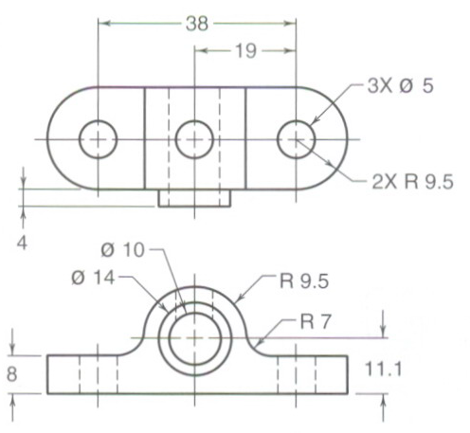
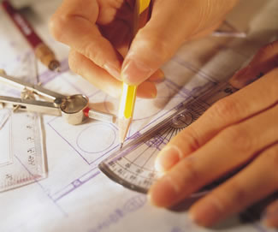
Instrument drawing
Instruments are used to draw straight lines, circles, and curves concisely and accurately. Thus, the drawings are usually made to scale.
Example

Slide 9


Computer drawing
The drawings are usually made by commercial software such as AutoCAD, solid works etc.
Example

Slide 10
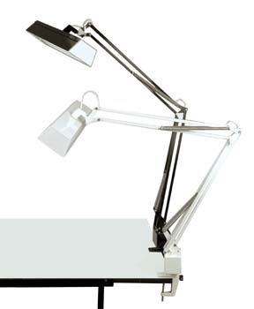
Engineering Drawing

Slide 11
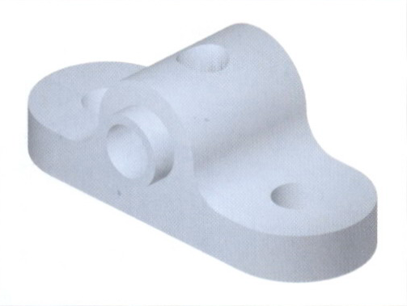
Elements of Engineering Drawing
Engineering drawing are made up of graphics language
and word language.
Graphics
language
Describe a shape (mainly).
Word
language
Describe size, location and specification of the object.

Slide 12
Basic Knowledge for Drafting
Graphics
language
Word
language
Line
types
Projection
method
Geometric
construction
Lettering

Slide 13


PROJECTION METHOD

Slide 14
PROJECTION METHOD
Perspective
Parallel
Oblique
Orthographic
Axonometric
Multiview

Slide 15
PROJECTION THEORY
The projection theory is used to graphically represent
3-D objects on 2-D media (paper, computer screen).
The projection theory is based on two variables:
1) Line of sight
2) Plane of projection (image plane or picture plane)

Slide 16
Line of sight is an imaginary ray of light between an
observer’s eye and an object.
There are 2 types of LOS :
parallel
and
converge
Parallel projection
Perspective projection
Line of sight
Line of sight

Slide 17
Plane of projection is an imaginary flat plane which
the image is created.
The image is produced by connecting the points where
the LOS pierce the projection plane.
Parallel projection
Perspective projection
Plane of projection
Plane of projection

Slide 18
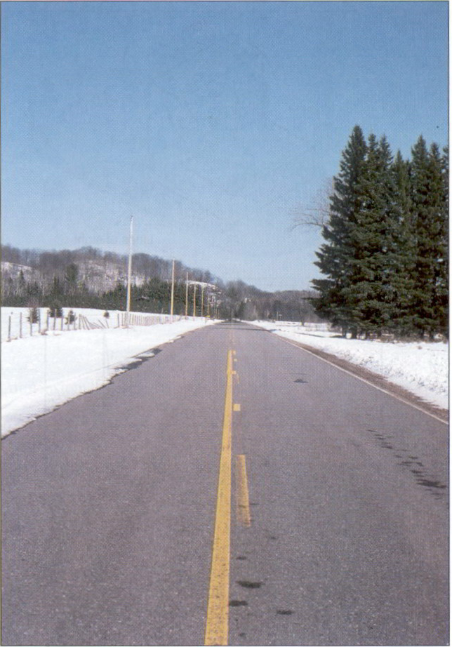
Disadvantage of Perspective Projection
Perspective projection is not
used by engineer for manu-
facturing of parts, because
1) It is difficult to create.
2) It does not reveal exact
shape and size.
Width is distorted

Slide 19

Orthographic Projection

Slide 20
MEANING
Orthographic projection is a parallel projection technique
in which the parallel lines of sight are perpendicular to the
projection plane
Object views from top
1
2
1
5
2
3
4
5
3
4
Projection plane

Slide 21
ORTHOGRAPHIC VIEW
Orthographic view depends on relative position of the object
to the line of sight.
Rotate
Two dimensions of an
object is shown.
Tilt
More than one view is needed
to represent the object.
Multiview drawing
Three dimensions of an object is shown.
Axonometric drawing

Slide 22
ORTHOGRAPHIC VIEW
NOTES
Orthographic projection technique can produce either 1. Multiview drawing that each view show an object in two dimensions.
2. Axonometric drawing that show all three dimensions of an object in one view.
Both drawing types are used in technical drawing for communication.

Slide 23
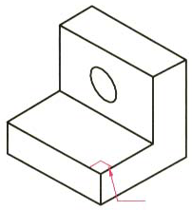
Axonometric (Isometric) Drawing
Advantage
Easy to understand
Disadvantage
Shape and angle distortion
Example
Distortions of shape and size in isometric drawing
Circular hole becomes ellipse.
Right angle becomes obtuse angle.

Slide 24
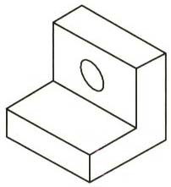
Multiview Drawing
Advantage
It represents accurate shape and size.
Disadvantage
Require practice in writing and reading.
Example
Multiviews drawing (2-view drawing)

Slide 25
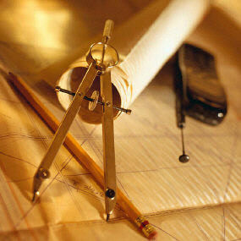


Drawing Standard

Slide 26
Introduction
Standards are set of rules that govern how technical drawings are represented.
Drawing standards are used so that drawings convey
the same meaning to everyone who reads them.

Slide 27
Standard Code
Country
Code
Full name
Thailand
มอก.
สำนักงานมาตรฐานผลิตภัณฑ์อุตสาหกรรม
USA
ANSI
American National Standard Institute
Japan
JIS
Japanese Industrial Standard
UK
BS
British Standard
Australia
AS
Australian Standard
Germany
DIN
Deutsches Institut für Normung
ISO
International Standards Organization

Slide 28
Partial List of Drawing Standards
Code number
Contents
มอก. 210 2520 วิธีเขียนแบบทั่วไป : ทางเครื่องกล
มอก. 440 ล.1 2541 การเขียนแบบก่อสร้างเล่ม 1 ทั่วไป
มอก. 446 ล.4 2532 ข้อแนะนำสำหรับการเขียนแผนภาพ วงจรไฟฟ้า
มอก. 1473 2540 การเขียนแบบเทคนิค การติดตั้ง สัญลักษณ์สำหรับระบบท่อของเหลว
ระบบทำความร้อน การระบายอากาศ
และระบบท่ออากาศ
ที่มา : http://library.tisi.go.th/data/lib_resources/pdf/catalog-online49/tis/02_ICS.pdf

Slide 29
Partial List of Drawing Standards
Code number
Contents
JIS Z 8311 Sizes and Format of Drawings
JIS Z 8312 Line Conventions
JIS Z 8313 Lettering
JIS Z 8314 Scales
JIS Z 8315 Projection methods
JIS Z 8316 Presentation of Views and Sections
JIS Z 8317 Dimensioning

Slide 30
Drawing Sheet
Trimmed paper of
a size A0 ~ A4.
A4
A3
Standard sheet size (JIS)
A4 210 x 297
A3 297 x 420
A2 420 x 594
A1 594 x 841
A0 841 x 1189
A2
A1
(Dimensions in millimeters)
A0

Slide 31
Orientation of drawing sheet
1. Type X (A0~A4)
2. Type Y (A4 only)
c
d
d
c
Drawing
space
Border
lines
Drawing space
Title block
Title block
c
Sheet size(mm) c (mm) d (mm)
A4 10 25
A3 10 25
A2 10 25
A1 20 25
A0 20 25

Slide 32
Drawing Scales
Length, size
Scale is the ratio of the linear dimension of an element
of an object shown in the drawing to the real linear
dimension of the same element of the object.
Size in drawing
Actual size
:

Slide 33
Drawing Scales
Designation of a scale consists of the word “SCALE”
followed by the indication of its ratio, as follow
SCALE 1:1 for full size
SCALE X:1 for enlargement scales (X > 1)
SCALE 1:X for reduction scales (X > 1)
Dimension numbers shown in the drawing are correspond
to “true size” of the object and they are independent of
the scale used in creating that drawing.

Slide 34
Basic Line Types
Name according
to application
Types of Lines
Appearance
Continuous thick line
Visible line
Continuous thin line
Dimension line
Extension line
Leader line
Dash thick line
Hidden line
Chain thin line
Center line
NOTE : We will learn other types of line in later chapters.

Slide 35
Meaning of Lines
Visible lines represent features that can be seen in the
current view
Hidden lines represent features that can not be seen in the current view
Center line represents symmetry, path of motion, centers of circles, axis of axisymmetrical parts
Dimension and Extension lines indicate the sizes and location of features on a drawing

Slide 36
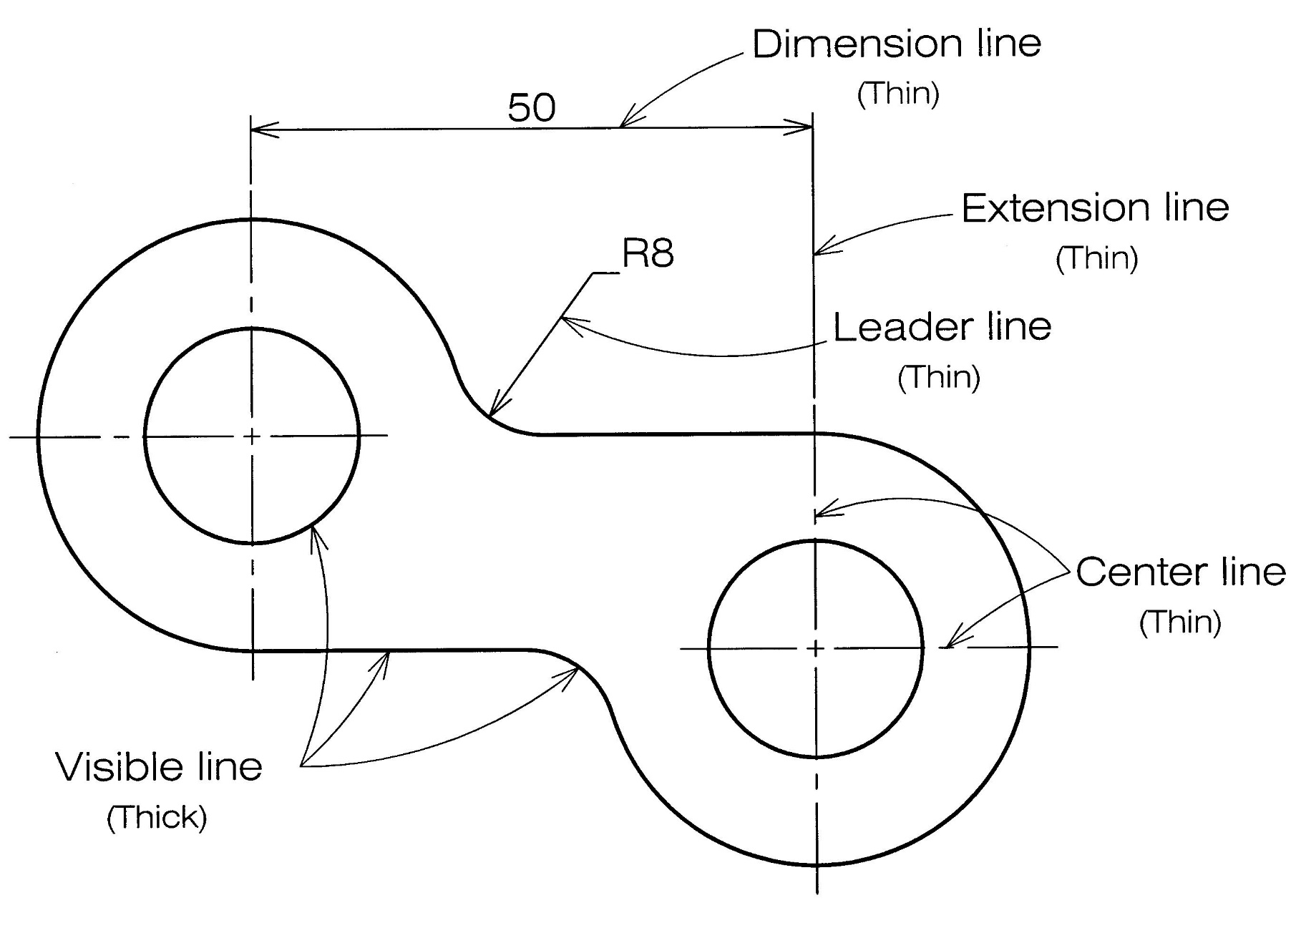
Example : Line conventions in engineering drawing

Slide 37
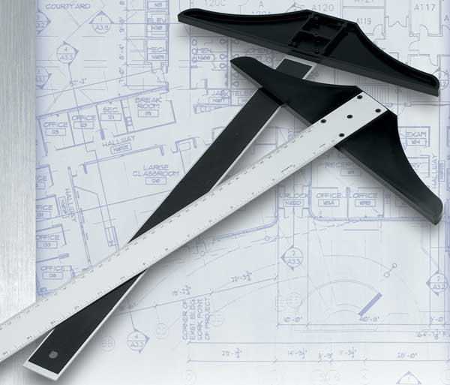
Traditional Drawing Tools

Slide 38
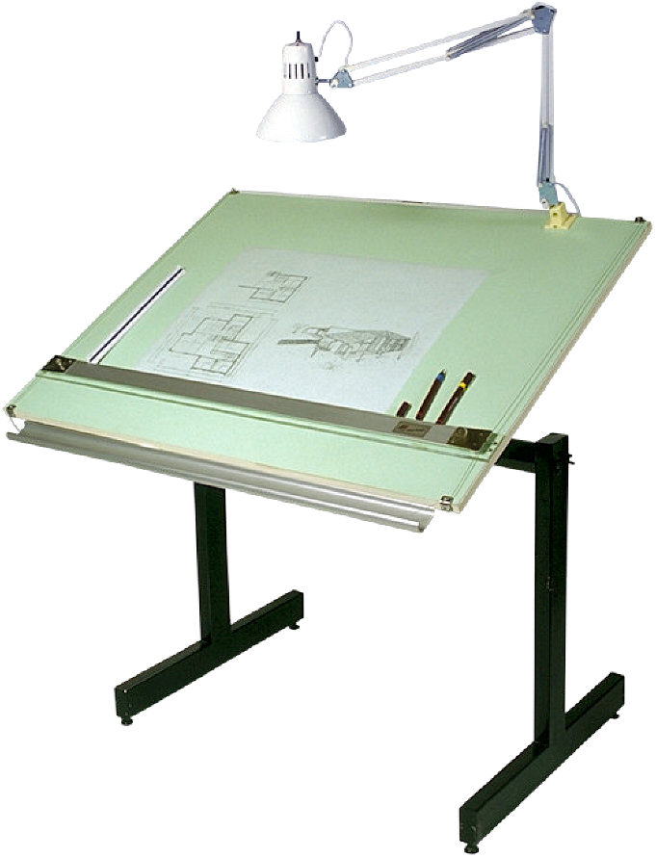
DRAWING TOOLS

Slide 39
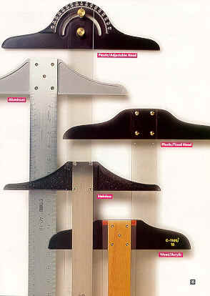
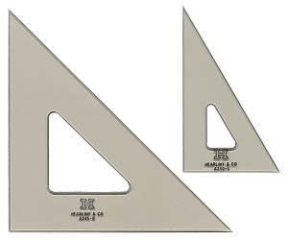
DRAWING TOOLS
1. T-Square
2. Triangles

Slide 40
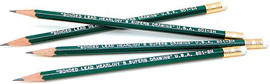
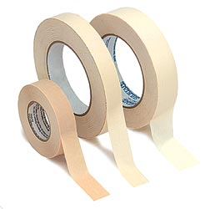
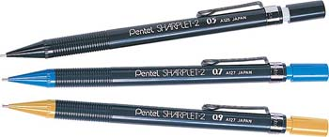
DRAWING TOOLS
2H or HB for thick line
4H for thin line
3. Adhesive Tape
4. Pencils

Slide 41
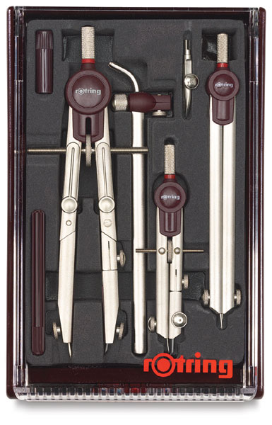

DRAWING TOOLS
5. Sandpaper
6. Compass

Slide 42

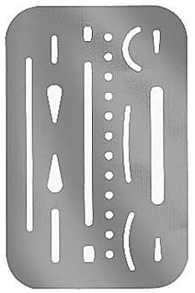
DRAWING TOOLS
7. Pencil Eraser
8. Erasing Shield

Slide 43

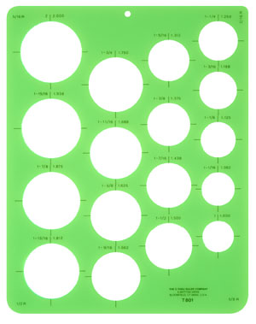
DRAWING TOOLS
9. Circle Template
10. Tissue paper

Slide 44

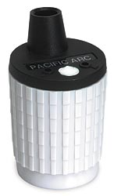
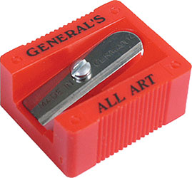
DRAWING TOOLS
11. Sharpener
12. Clean paper

Slide 45
ABCDEFGHIJKLMNOPQRSTUVWXYZABCDEFGHIJKLMNOPQRSTUVWXYZABCDEF
Lettering
ABCDEFGHIJKLMNOPQRSTUVWXYZABCDEFGHIJKLMNOPQRSTUVWXYZABCDEF

Slide 46
Text on Drawings
Text on engineering drawing is used :
To communicate nongraphic information.
As a substitute for graphic information, in those instance where text can communicate the needed information more clearly and quickly.
Thus, it must be written with
Legibility
- shape
- space between letters and words
Uniformity
- size - line thickness

Slide 47
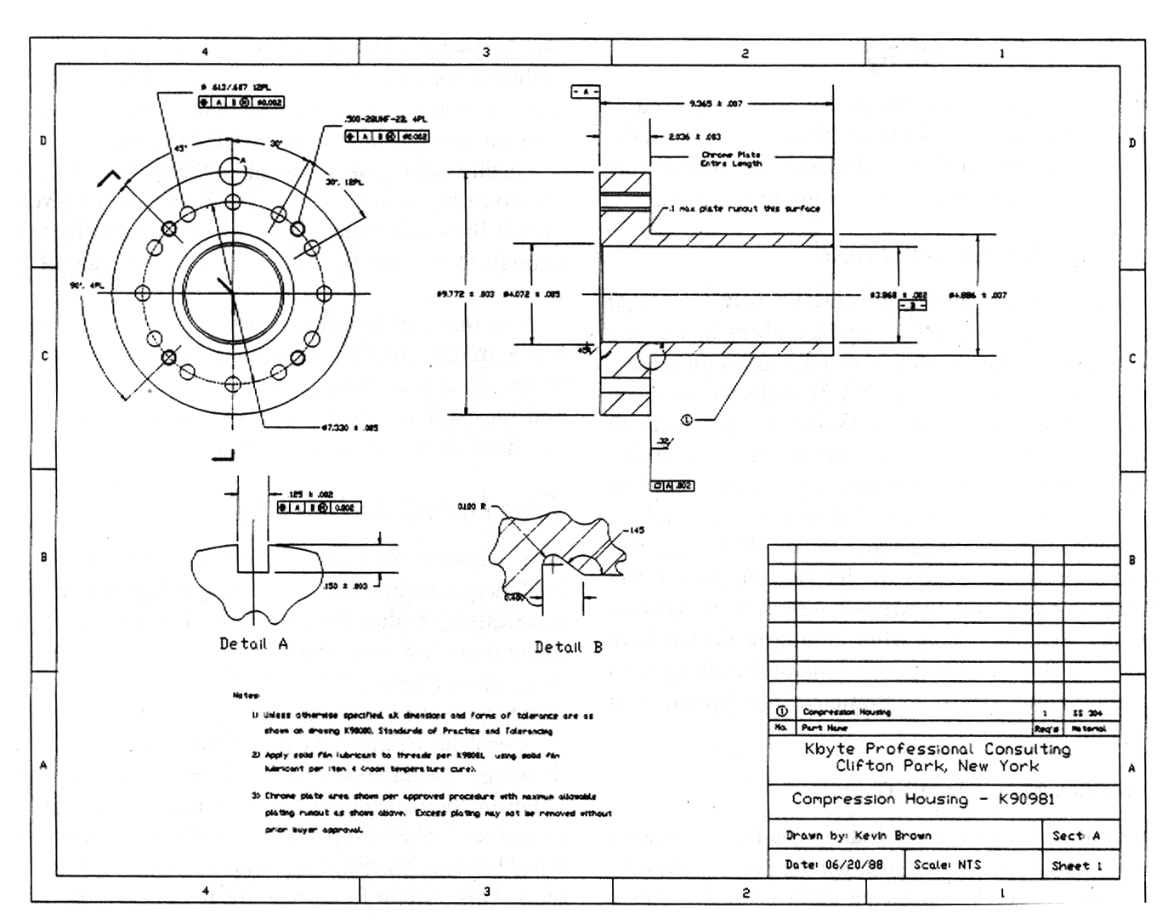
Example
Placement of the text on drawing
Dimension & Notes
Notes
Title Block

Slide 48
Lettering Standard
ANSI Standard
This course
Use a Gothic text style,
either inclined or vertical.
Use only a vertical Gothic
text style.
Use all capital letters.
Use both capital and
lower-case letters.
Use 3 mm for most
text height.
Same. For letters in title block it is recommend to use 5~8 mm text height
Space between lines
of text is at least 1/3
of text height.
N/A. Follows ANSI rule.

Slide 49
Basic Strokes
Straight
Slanted
Horizontal
Curved
Examples : Application of basic stroke
4
5
“I” letter
1
“A” letter
1
2
“B” letter
1
3
6
3
2

Slide 50
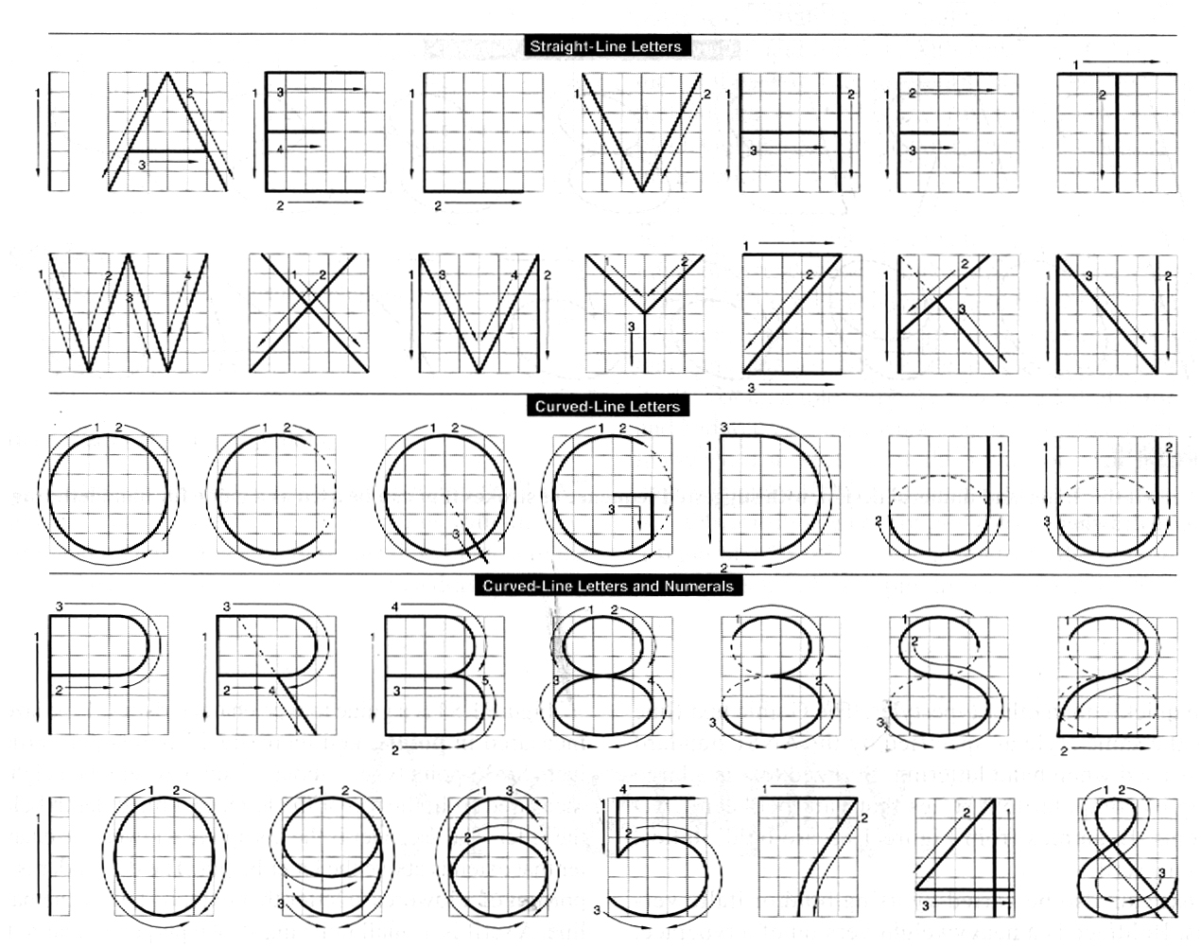
Suggested Strokes Sequence
Upper-case letters & Numerals
Straight line
letters
Curved line
letters
Curved line
letters &
Numerals

Slide 51
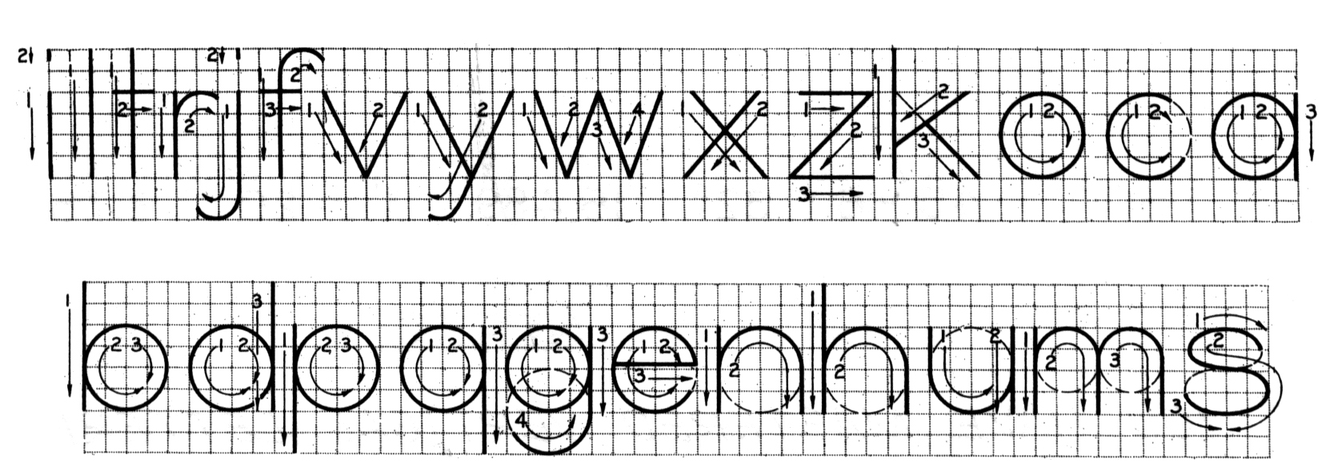
Suggested Strokes Sequence
Lower-case letters
The text’ s body height is about 2/3 the height of a capital letter.

Slide 52
Stroke Sequence
I
L
T
F
E
H

Slide 53
Stroke Sequence
V
X
W

Slide 54
Stroke Sequence
N
M
K
Z
Y
A
4

Slide 55
Stroke Sequence
O
Q
C
G

Slide 56
Stroke Sequence
D
U
P
B
R
J
1
2

Slide 57
Stroke Sequence
5
7

Slide 58
Stroke Sequence
S
0
3
6
8
9

Slide 59
Stroke Sequence
l
i

Slide 60
Stroke Sequence
v
w
x
k
z

Slide 61
Stroke Sequence
j
y
f
t
r

Slide 62
Stroke Sequence
c
o
a
b
d
p
q
e

Slide 63
Stroke Sequence
g
n
m
h
u
s

Slide 64
Word Composition
Look at the same word having different spacing between letters.
A) Non-uniform spacing
JIRAPONG
B) Uniform spacing
J
I
R
A
P
O
N
G
Which one is easier to read ?

Slide 65
Word Composition
JIRAPONG
Spacing
|
\ /
|
|
|
|
|
|
\
)(
)
(
Contour
General conclusions are:
Space between the letters depends on the contour of
the letters at an adjacent side.
Good spacing creates approximately equal background area between letters.

Slide 66
Space between Letters
1. Straight - Straight
3. Straight - Slant
2. Straight - Curve
4. Curve - Curve

Slide 67
Space between Letters
5. Curve - Slant
6. Slant - Slant
7. The letter “L” and “T”
≡
slant
slant
≡
slant
straight

Slide 68
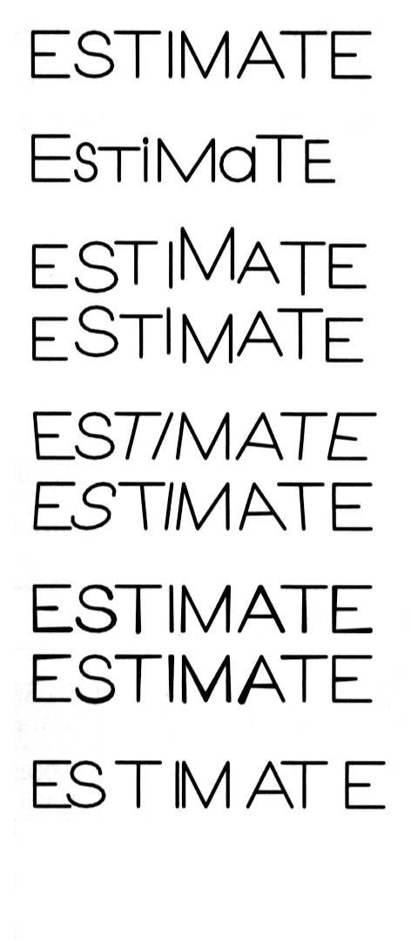

Example : Good and Poor Lettering
GOOD
Not uniform in style.
Not uniform in height.
Not uniformly vertical or inclined.
Not uniform in thickness of stroke.
Area between letters not uniform.
Area between words not uniform.

Slide 69
Sentence Composition
Leave the space between words equal to the space requires for writing a letter “O”.
Example
ALL
O
DIMENSIONS
O
ARE
O
IN
MILLIMETERS
O
UNLESS
OTHERWISE
O
SPECIFIED.

Slide 70
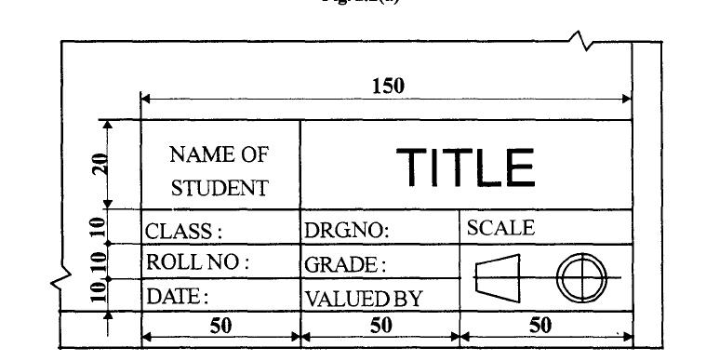

Slide 71
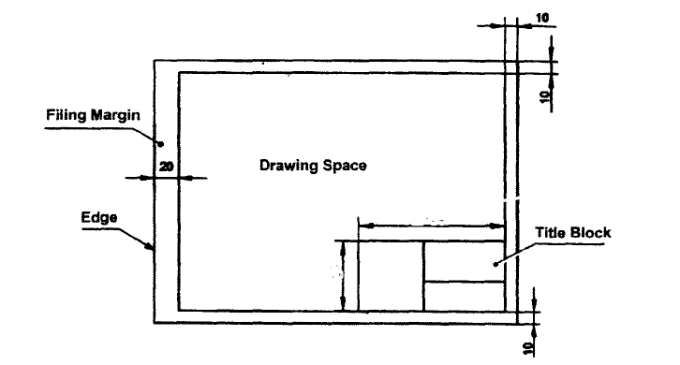

Slide 73
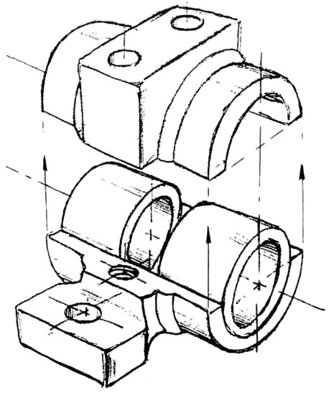
Freehand Sketching

Slide 74
Straight Line
1. Hold the pencil naturally.
2. Spot the beginning and end points.
3. Swing the pencil back and forth between the points, barely
touching the paper until the direction is clearly established.
4. Draw the line firmly with a free and easy wrist-and-arm motion

Slide 75
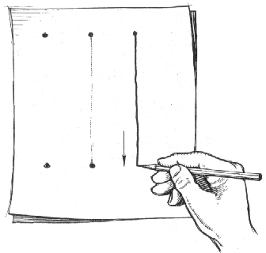
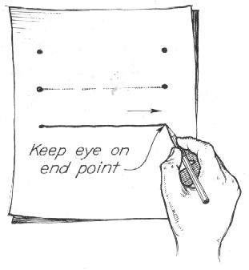
Horizontal line
Vertical line

Slide 76
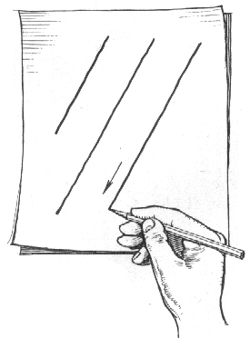
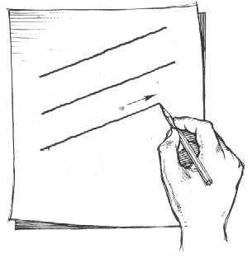
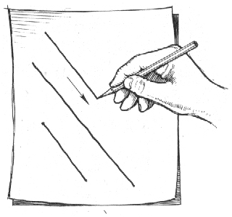
Nearly vertical
inclined line
Nearly horizontal
inclined line

Slide 77
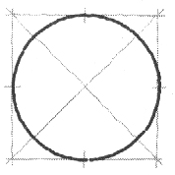
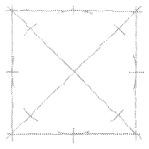
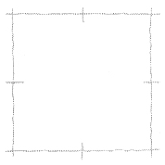
Small Circle
Method 1 : Starting with a square
1. Lightly sketching the square and marking the mid-points.
2. Draw light diagonals and mark the estimated radius.
3. Draw the circle through the eight points.
Step 1
Step 2
Step 3

Slide 78
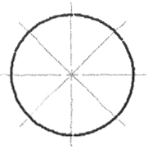
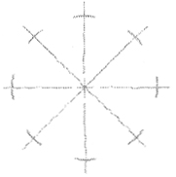
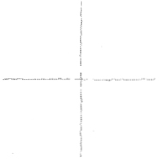
Small Circle
Method 2 : Starting with center line
1. Lightly draw a center line.
2. Add light radial lines and mark the estimated radius.
3. Sketch the full circle.
Step 1
Step 2
Step 3

Slide 79
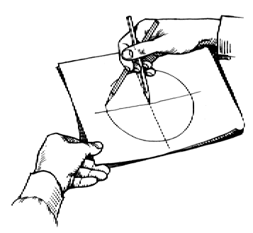
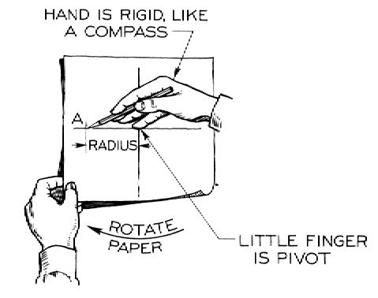
Large Circle
Place the little finger (or pencil’ s tip) at the center as a pivot, and set the pencil point at the radius-distance from the center.
Hold the hand in this position and rotate the paper.

Slide 80
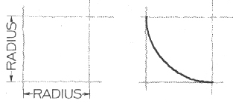
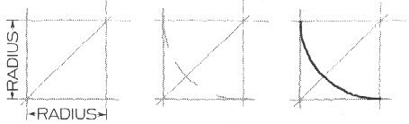
Arc
Method 1 : Starting with a square
Method 2 : Starting with a center line

Slide 81
Steps in Sketching
1. Block in main shape.
2. Locate the features.
3. Sketch arcs and circles.
4. Sketch lines.

Slide 82
Example

